Slide 1
ARTIFICIAL INTELLIGENCE
&
MACHINE LEARNING
SESSION NO :13
Linear Algebra
Vectors, matrices, matrix operations, eigendecomposition, SVD

Slide 2
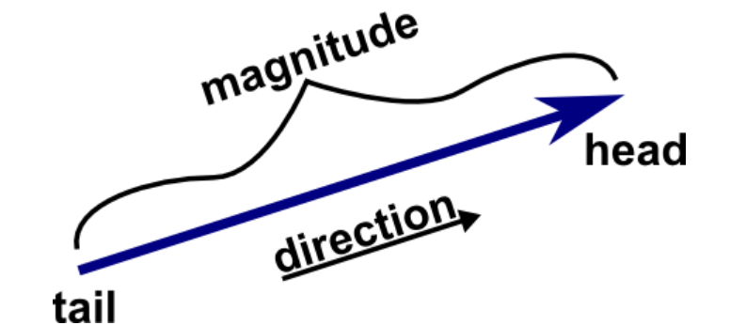
Definition of a vector
A vector is an object that has both a magnitude and a direction. Geometrically, a vector as a directed line segment, whose length is the magnitude of the vector and with an arrow indicating the direction.
Example: → If you walk 3 km east, the vector is (3,0).
If you walk 4 km north, the vector is (0,4).
The total distance = √(3²+4²)=5 km (Pythagoras).

Slide 3
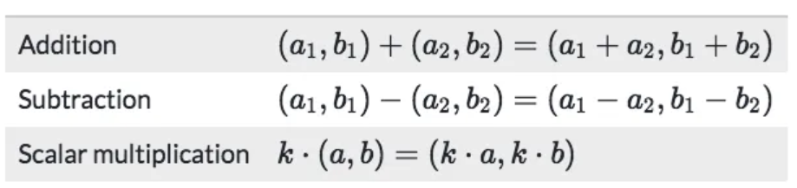
Vector operations
Example:
Vector A = (2,3), Vector B = (1,4)
A + B = (2+1, 3+4) = (3,7)
A - B = (2-1, 3-4) = (1,-1)

Slide 4
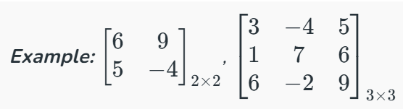
What is Matrix?
In mathematics, a matrix is a rectangular array of numbers, symbols, or expressions, arranged in rows and columns.
These elements are often called entries or elements of the matrix.
Matrices are fundamental in various mathematical fields like linear algebra, and they can represent linear transformations, systems of equations, and more.

Slide 5
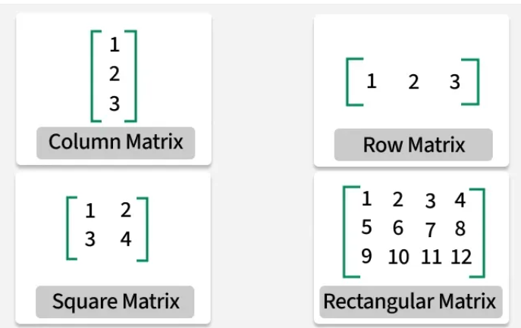
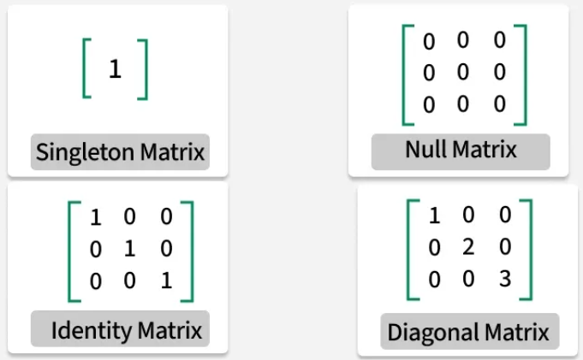
Types of Matrix

Slide 6
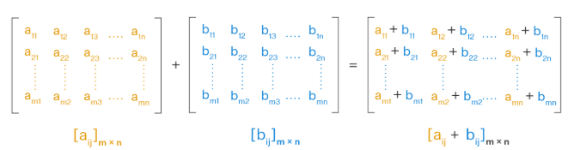
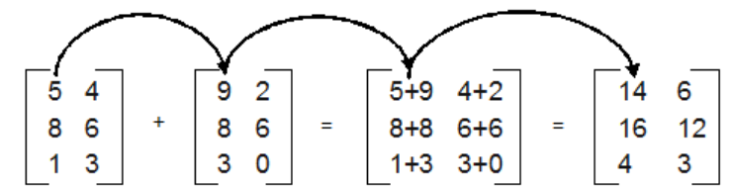
Matrix Operation: Addition

Slide 7
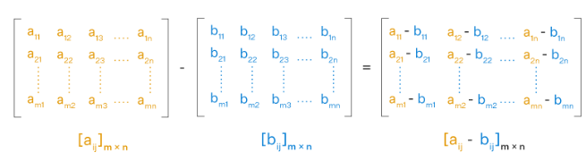
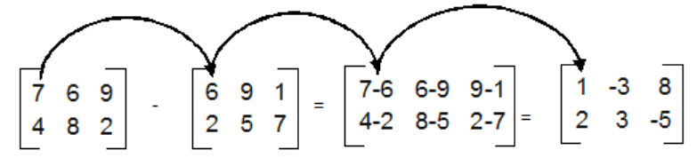
Matrix Operation: Subtraction

Slide 8
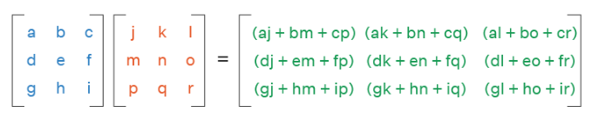
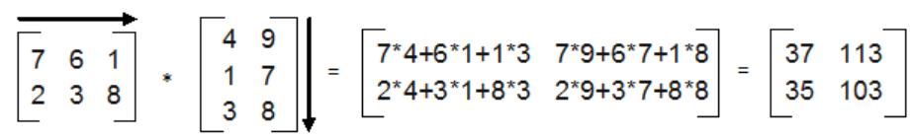
Matrix Operation: Multiplication

Slide 9
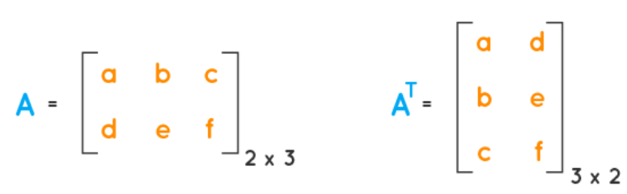
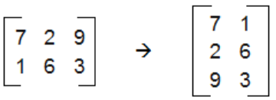
Transpose of a Matrix

Slide 10
Matrix Operations
Transpose of Matrix
Inverse of Matrix
Transpose means flip rows & columns.
A = [[1,2],[3,4]]
Aᵀ = [[1,3],[2,4]]
For A = [[1,2],[3,4]]
Inverse A⁻¹ = (1/(1*4-2*3)) * [[4,-2],[-3,1]]
= [[-2,1],[1.5,-0.5]]

Slide 11
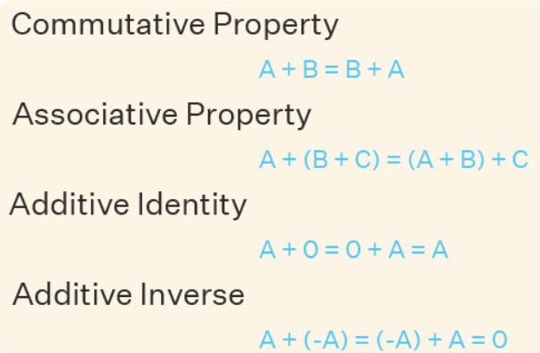
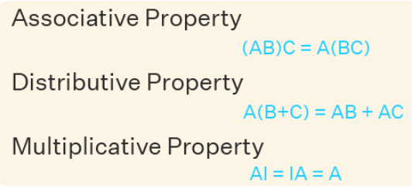
Properties of Matrix Addition & Matrix Multiplication

Slide 12
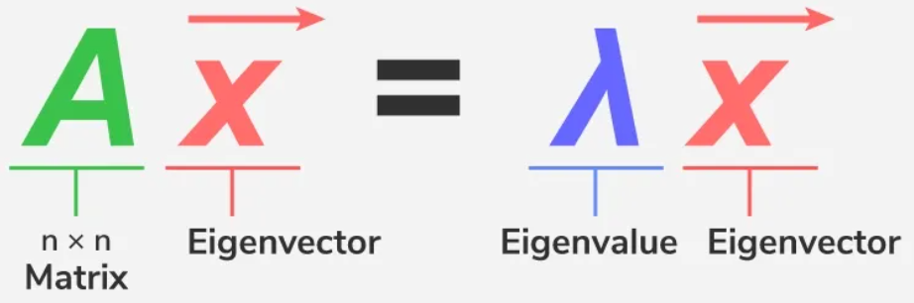
Eigenvalues and Eigenvectors
Eigenvalues and eigenvectors are fundamental concepts in linear algebra, used in various applications such as matrix diagonalization, stability analysis and data analysis (e.g., PCA).
They are associated with a square matrix and provide insights into its properties.

Slide 13
Eigen Decomposition of a Matrix
Eigen decomposition is a method used in linear algebra to break down a square matrix into simpler components called eigenvalues and eigenvectors.
This process helps us understand how a matrix behaves and how it transforms data.
For Example - Eigen decomposition is particularly useful in fields like Physics, Machine learning, and Computer graphics, as it simplifies complex calculations.

Slide 14
Fundamental Theory of Eigen Decomposition
Eigen decomposition separates a matrix into its eigenvalues and eigenvectors.
Mathematically, for a square matrix A, if there exists a scalar λ (eigenvalue) and a non-zero vector v (eigenvector) such that:
Av = λv
Where:
  A is the matrix.
  λ is the eigenvalue.
  v is the eigenvector.

Slide 15
Fundamental Theory of Eigen Decomposition…
Then, the matrix A can then be represented as:
A=VΛV⁻¹
Where:
  V is the matrix of eigenvectors.
  Λ is the diagonal matrix of eigenvalues.
  V⁻¹ is the inverse of the matrix.
This decomposition is significant because it transforms matrix operations into simpler, scalar operations involving eigenvalues, making computations easier.

Slide 16
How to Perform Eigen decomposition?
Step 1: Find the Eigenvalues:
  Solve the characteristic equation:
  det (A−λI=0
  Here, A is the square matrix, λ is the eigenvalue, and I is the identity matrix of the same dimension as A.
Step 2: Find the Eigenvectors:
For each eigenvalue λ, substitute it back into the equation:
(A−λI)v=0
This represents a system of linear equations where v is the eigenvector corresponding to the eigenvalue λ.

Slide 17
How to Perform Eigen decomposition?...
Step 3: Construct the Eigenvector Matrix V:
Place all the eigenvectors as columns in the matrix V. If there are n distinct eigenvalues, V will be an n×n matrix..
Step 4 Form the Diagonal Matrix Λ:
Construct a diagonal matrix Λ by placing the eigenvalues on its diagonal:
Step 5: Calculate the Inverse of V:
Find V-1, the inverse of the eigenvector matrix V, if the matrix is invertible.

Slide 18

Example of Eigen Decomposition
Find the eigenvalues by solving det(A - λI) = 0

Slide 19
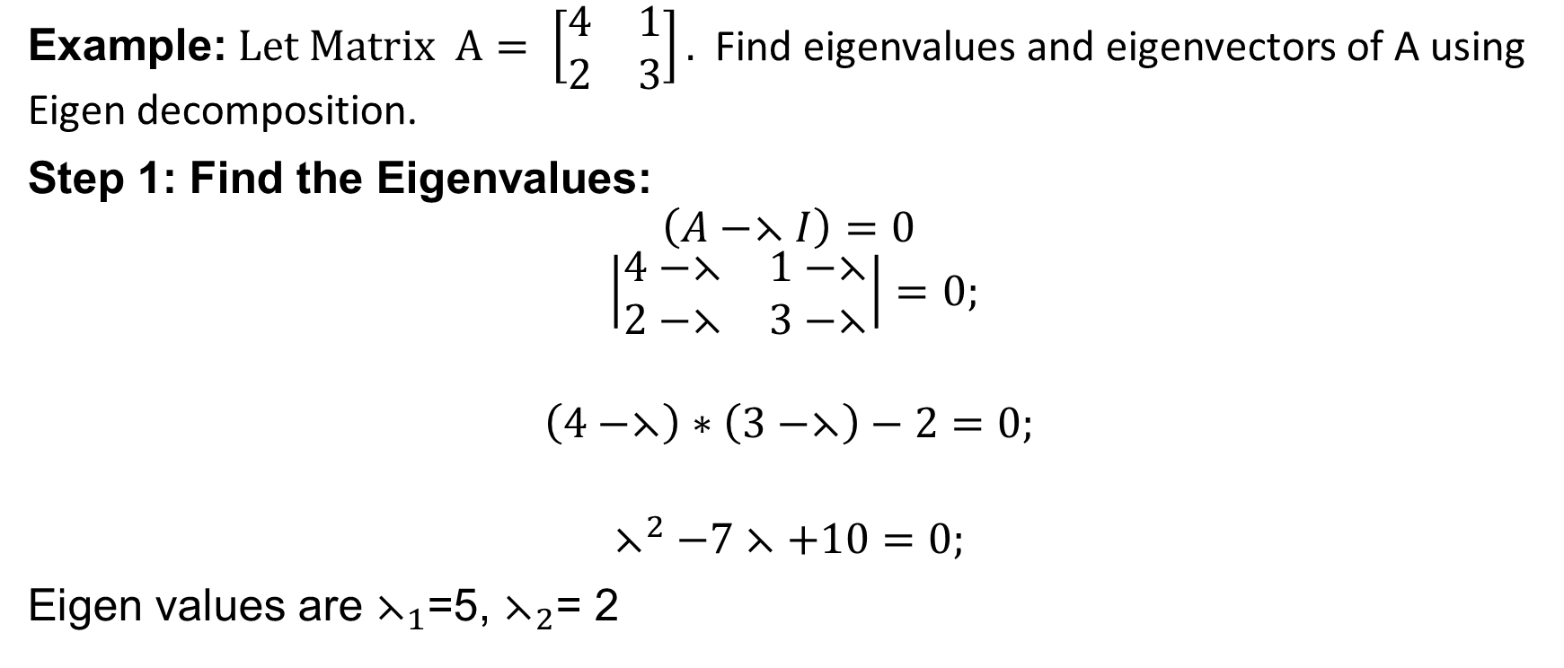
Eigen decomposition (Cont…I)
Example: $Let Matrix A= \left[\begin{matrix}4 & 1 \\ 2 & 3\end{matrix}\right].$ Find eigenvalues and eigenvectors of A using Eigen decomposition.
Step 1: Find the Eigenvalues:
$$\left(A−⋋I\right)=0$$
$$\left|\begin{matrix}4−⋋ & 1−⋋ \\ 2−⋋ & 3−⋋\end{matrix}\right|=0;$$
$$\left(4−⋋\right)∗\left(3−⋋\right)−2=0;$$
$$⋋^{2}−7⋋+10=0;$$
Eigen values are $⋋_{1}$=5, $⋋_{2}$= 2

Slide 20
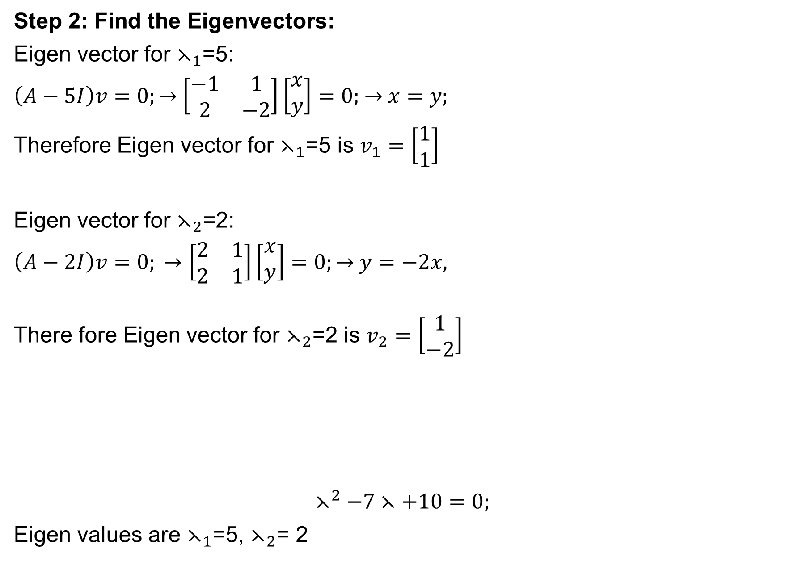
Eigen decomposition (Cont…II)
Step 2: Find the Eigenvectors:
Eigen vector for $⋋_{1}$=5:
$\left(A−5I\right)v=0;→$ $\left[\begin{matrix}−1 & 1 \\ 2 & −2\end{matrix}\right]\left[\begin{matrix}x \\ y\end{matrix}\right]=0;$ $→$ $x=y;$
Therefore Eigen vector for $⋋_{1}$=5 is $v_{1}=\left[\begin{matrix}1 \\ 1\end{matrix}\right]$
Eigen vector for $⋋_{2}$=2:
$\left(A−2I\right)v=0; →\left[\begin{matrix}2 & 1 \\ 2 & 1\end{matrix}\right]\left[\begin{matrix}x \\ y\end{matrix}\right]=0;→$ $y=−2x,$
There fore Eigen vector for $⋋_{2}$=2 is $v_{2}=\left[\begin{matrix}1 \\ −2\end{matrix}\right]$
$$⋋^{2}−7⋋+10=0;$$
Eigen values are $⋋_{1}$=5, $⋋_{2}$= 2

Slide 21
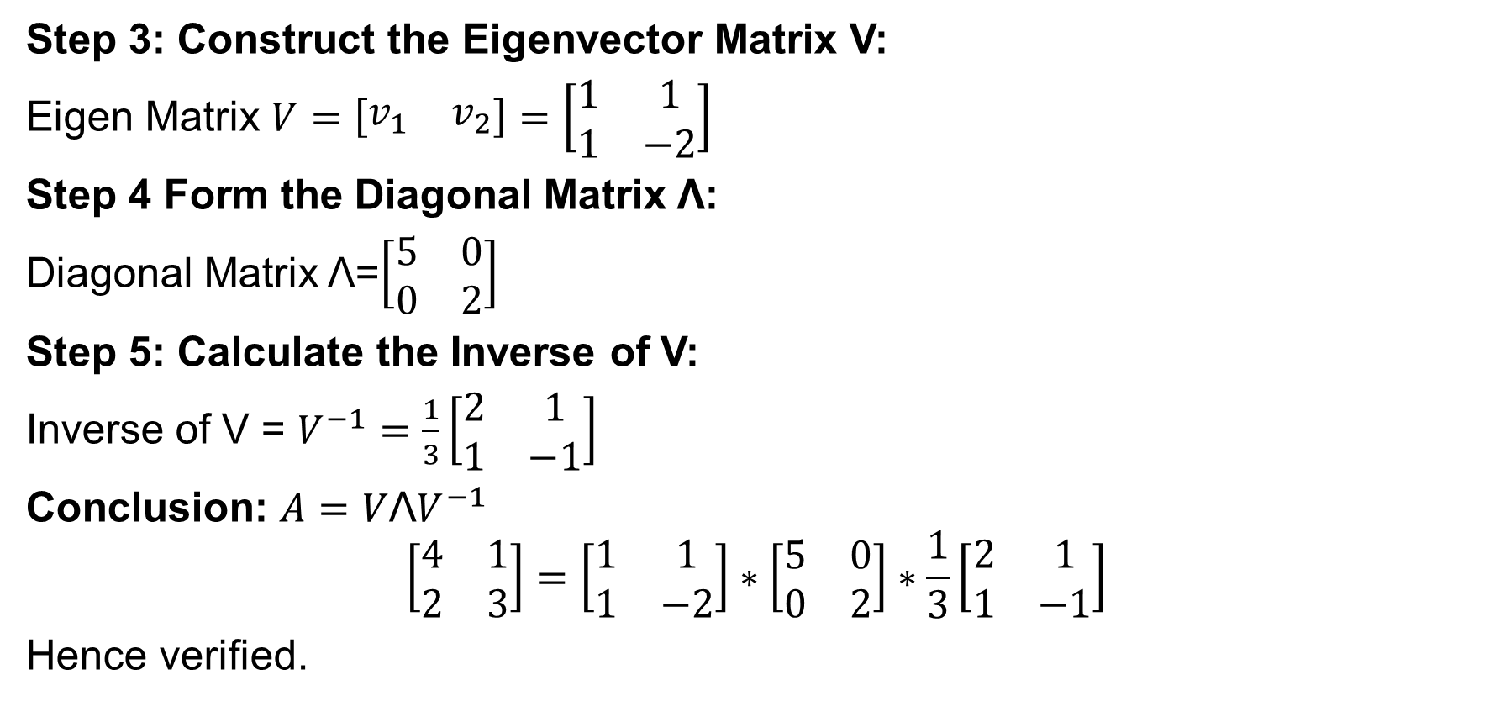
Eigen decomposition (Cont…III)
Step 3: Construct the Eigenvector Matrix V:
Eigen Matrix $V=\left[\begin{matrix}v_{1} & v_{2}\end{matrix}\right]=\left[\begin{matrix}1 & 1 \\ 1 & −2\end{matrix}\right]$
Step 4 Form the Diagonal Matrix Λ:
Diagonal Matrix Λ=$\left[\begin{matrix}5 & 0 \\ 0 & 2\end{matrix}\right]$
Step 5: Calculate the Inverse of V:
Inverse of V = $V^{−1}=\frac{1}{3}\left[\begin{matrix}2 & 1 \\ 1 & −1\end{matrix}\right]$
Conclusion: $A=V{\text{Λ}V}^{−1}$
$$\left[\begin{matrix}4 & 1 \\ 2 & 3\end{matrix}\right]=\left[\begin{matrix}1 & 1 \\ 1 & −2\end{matrix}\right]∗\left[\begin{matrix}5 & 0 \\ 0 & 2\end{matrix}\right]∗\frac{1}{3}\left[\begin{matrix}2 & 1 \\ 1 & −1\end{matrix}\right]$$
Hence verified.

Slide 22
Applications of Singular Value Decomposition (SVD)
SVD has some fascinating algebraic characteristics and conveys relevant geometrical and theoretical insights regarding linear transformations.
SVD has some critical applications in data science too.
Mathematical applications of the SVD involve calculating the matrix approximation, rank of a matrix and so on.
The SVD is also greatly useful in science and engineering.
It has some applications of statistics, for example, least-squares fitting of data and process control.

Slide 23
Singular Value Decomposition
Singular Value Decomposition (SVD) is a powerful matrix factorization technique in linear algebra.
It decomposes a matrix into three other matrices, revealing important information about the original matrix's structure and properties.
SVD helps you split that table into three parts:
  U: This part tells you about the people (like their general preferences).
  Σ: This part shows how important each factor is (how much each rating matters).
  Vᵀ: This part tells you about the products (how similar they are to each other)

Slide 24

Singular Value Decomposition…
SVD deals with decomposing a matrix into a product of 3 matrices as shown:
If the dimensions of A are m x n:
  U is an m x m matrix of Left Singular Vectors
  S is an m x n rectangular diagonal matrix of Singular Values arranged in decreasing order
  V is an n x n matrix of Right Singular Vectors
The decomposition allows us to express our original matrix as a linear combination of low-rank matrices.

Slide 25


How to perform Singular Value Decomposition
Step 1: Compute
Step 2: Find the Eigenvalues of
Step 3: Find the Right Singular Vectors
Step 4: Compute the Left Singular Vectors (Matrix U)
Step 5: Final SVD Equation

Slide 26
Applications of SVD
Digital Signal Processing: SVD can be used to analyze signals and filter noise.
Image Processing: SVD is used for image compression and denoising. It helps in reducing the dimensionality of image data by preserving the most significant singular values and discarding the rest.

Slide 27
Singular Value Decomposition (SVD)
Sing Singular Value Decomposition (SVD)
Singular Value Decomposition (SVD)
Singular Value Decomposition (SVD) is a factorization method in linear algebra that decomposes a matrix into three other matrices, providing a way to represent data in terms of its singular values.
SVD helps you split that table into three parts:
U: This part tells you about the people (like their general preferences).
Σ: This part shows how important each factor is (how much each rating matters).
Vᵀ: This part tells you about the products (how similar they are to each other)s with help of an

Slide 28
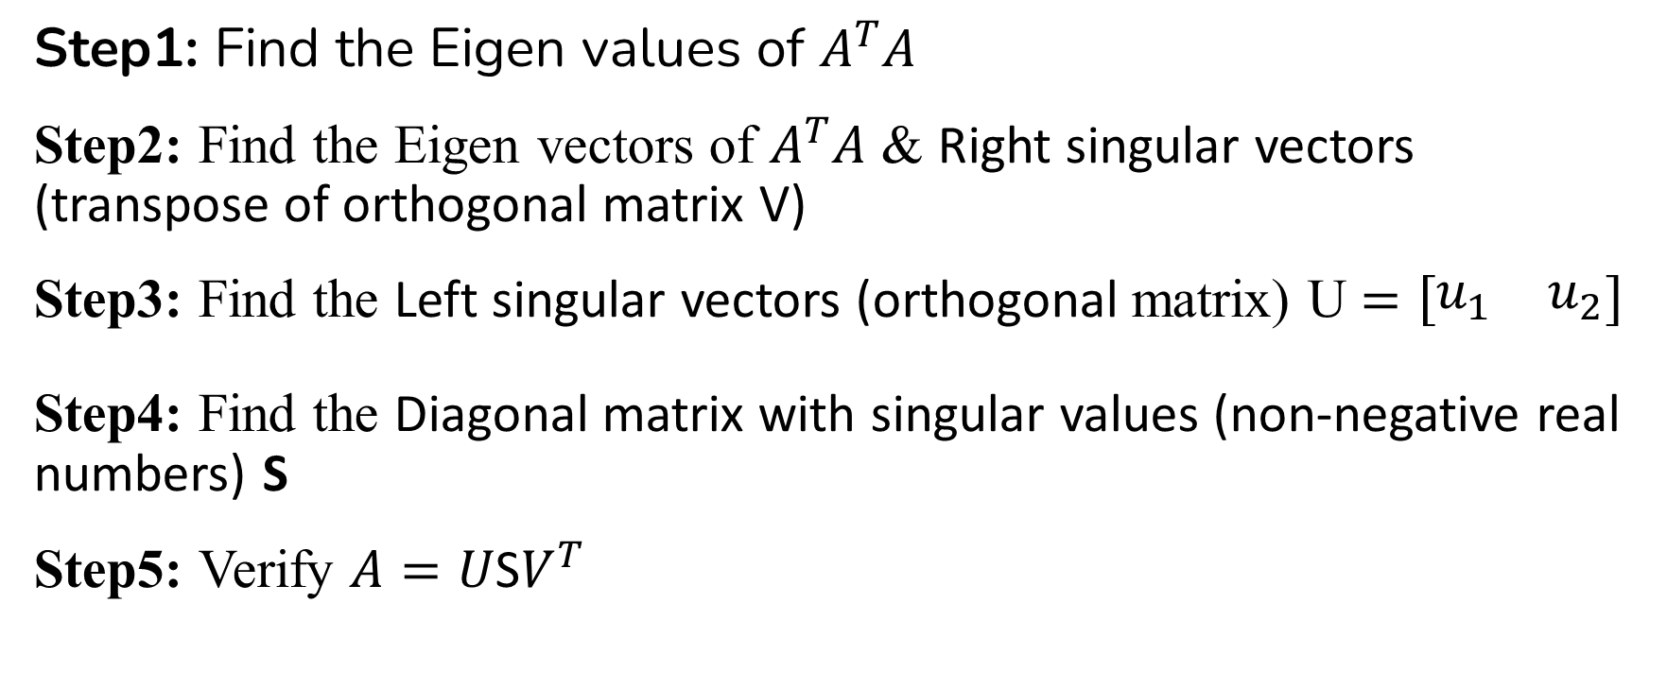
Singular Value Decomposition (SVD)
Sing Singular Value Decomposition (SVD)
Steps Steps for Singular Value Decomposition (SVD)
Step1: Find the Eigen values of $A^{T}A$
Step2: Find the Eigen vectors of $A^{T}A$ & Right singular vectors (transpose of orthogonal matrix V)
Step3: Find the Left singular vectors (orthogonal matrix) U $=\left[\begin{matrix}u_{1} & u_{2}\end{matrix}\right]$
Step4: Find the Diagonal matrix with singular values (non-negative real numbers) S
Step5: Verify $A=U\text{S}V^{T}$

Slide 29
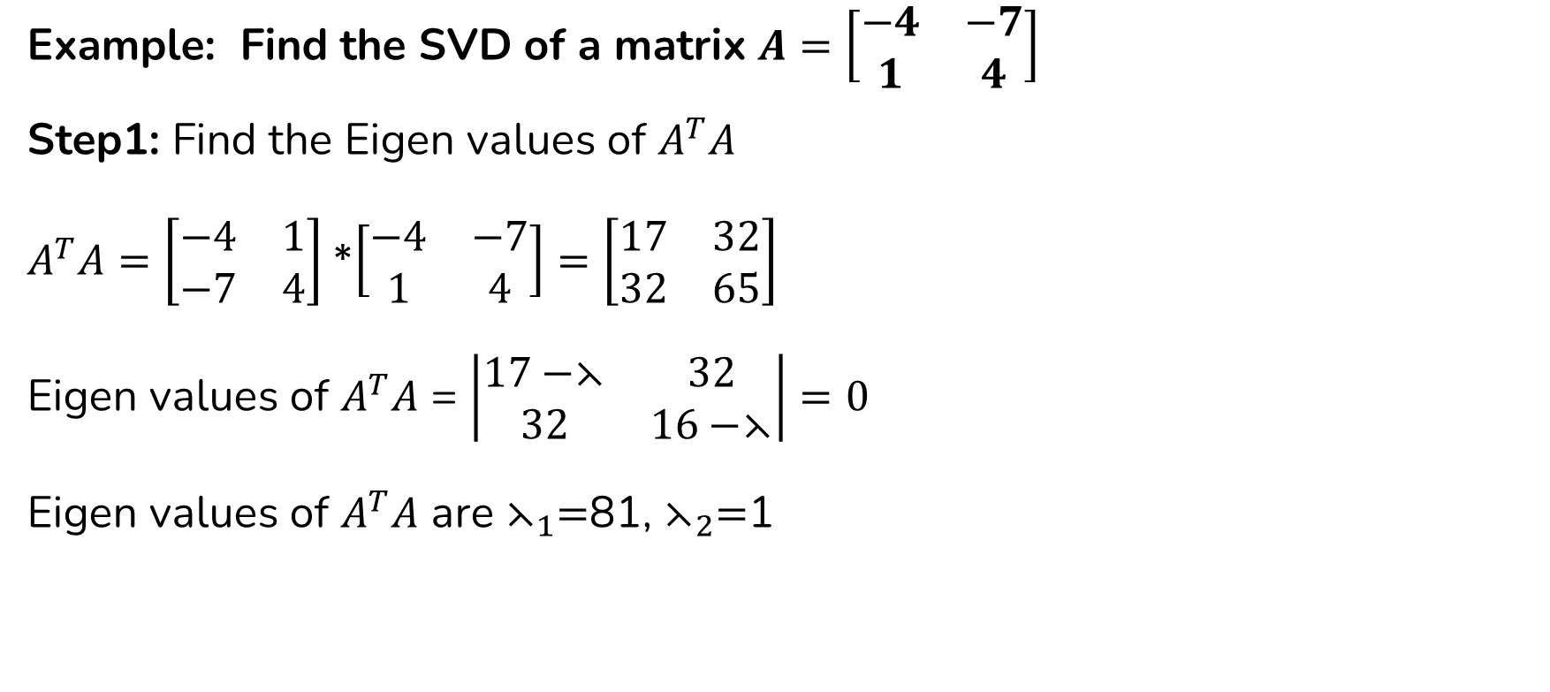
Singular Value Decomposition (SVD)
Sing Singular Value Decomposition (SVD)
Singular Value Decomposition (SVD) (Cont..I)
Example: Find the SVD of a matrix $A=\left[\begin{matrix}−4 & −7 \\ 1 & 4\end{matrix}\right]$
Step1: Find the Eigen values of $A^{T}A$
$A^{T}A=\left[\begin{matrix}−4 & 1 \\ −7 & 4\end{matrix}\right]$ *$\left[\begin{matrix}−4 & −7 \\ 1 & 4\end{matrix}\right]=\left[\begin{matrix}17 & 32 \\ 32 & 65\end{matrix}\right]$
Eigen values of $A^{T}A$ = $\left|\begin{matrix}17−⋋ & 32 \\ 32 & 16−⋋\end{matrix}\right|=0$
Eigen values of $A^{T}A$ are $⋋_{1}=$81, $⋋_{2}=$1

Slide 30
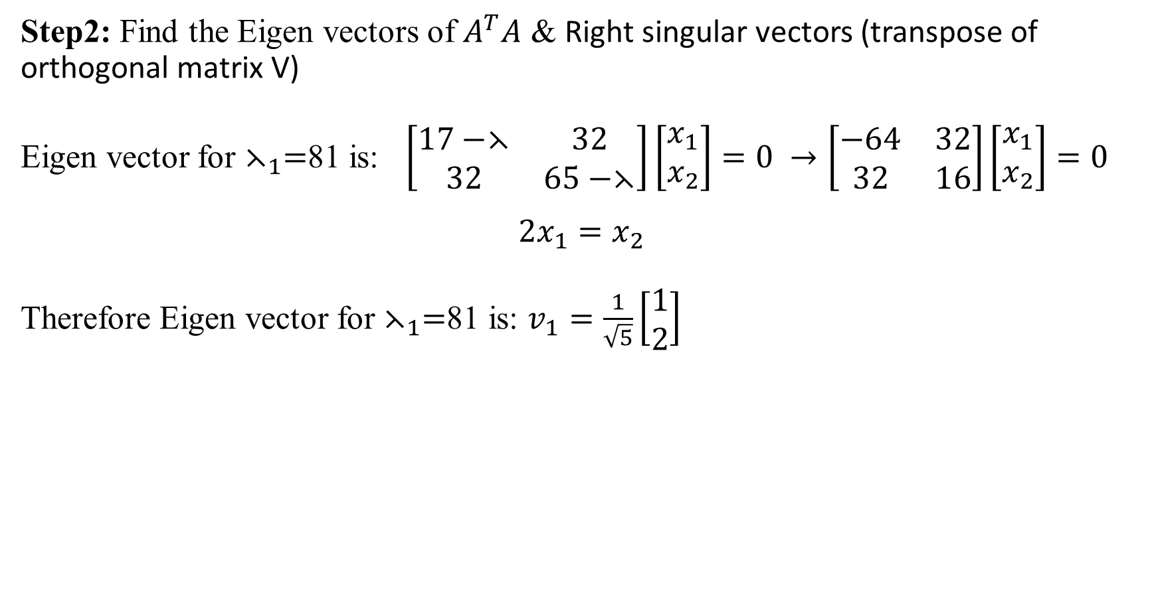
Singular Value Decomposition (SVD)
Sing Singular Value Decomposition (SVD)
Singular Value Decomposition (SVD) (Cont..II)
Step2: Find the Eigen vectors of $A^{T}A$ & Right singular vectors (transpose of orthogonal matrix V)
Eigen vector for $⋋_{1}=$81 is: $\left[\begin{matrix}17−⋋ & 32 \\ 32 & 65−⋋\end{matrix}\right]\left[\begin{matrix}x_{1} \\ x_{2}\end{matrix}\right]=0 →\left[\begin{matrix}−64 & 32 \\ 32 & 16\end{matrix}\right]\left[\begin{matrix}x_{1} \\ x_{2}\end{matrix}\right]=0$
$$2x_{1}=x_{2}$$
Therefore Eigen vector for $⋋_{1}=$81 is: $v_{1}=\frac{1}{\sqrt{5}}\left[\begin{matrix}1 \\ 2\end{matrix}\right]$
this with help of an

Slide 31
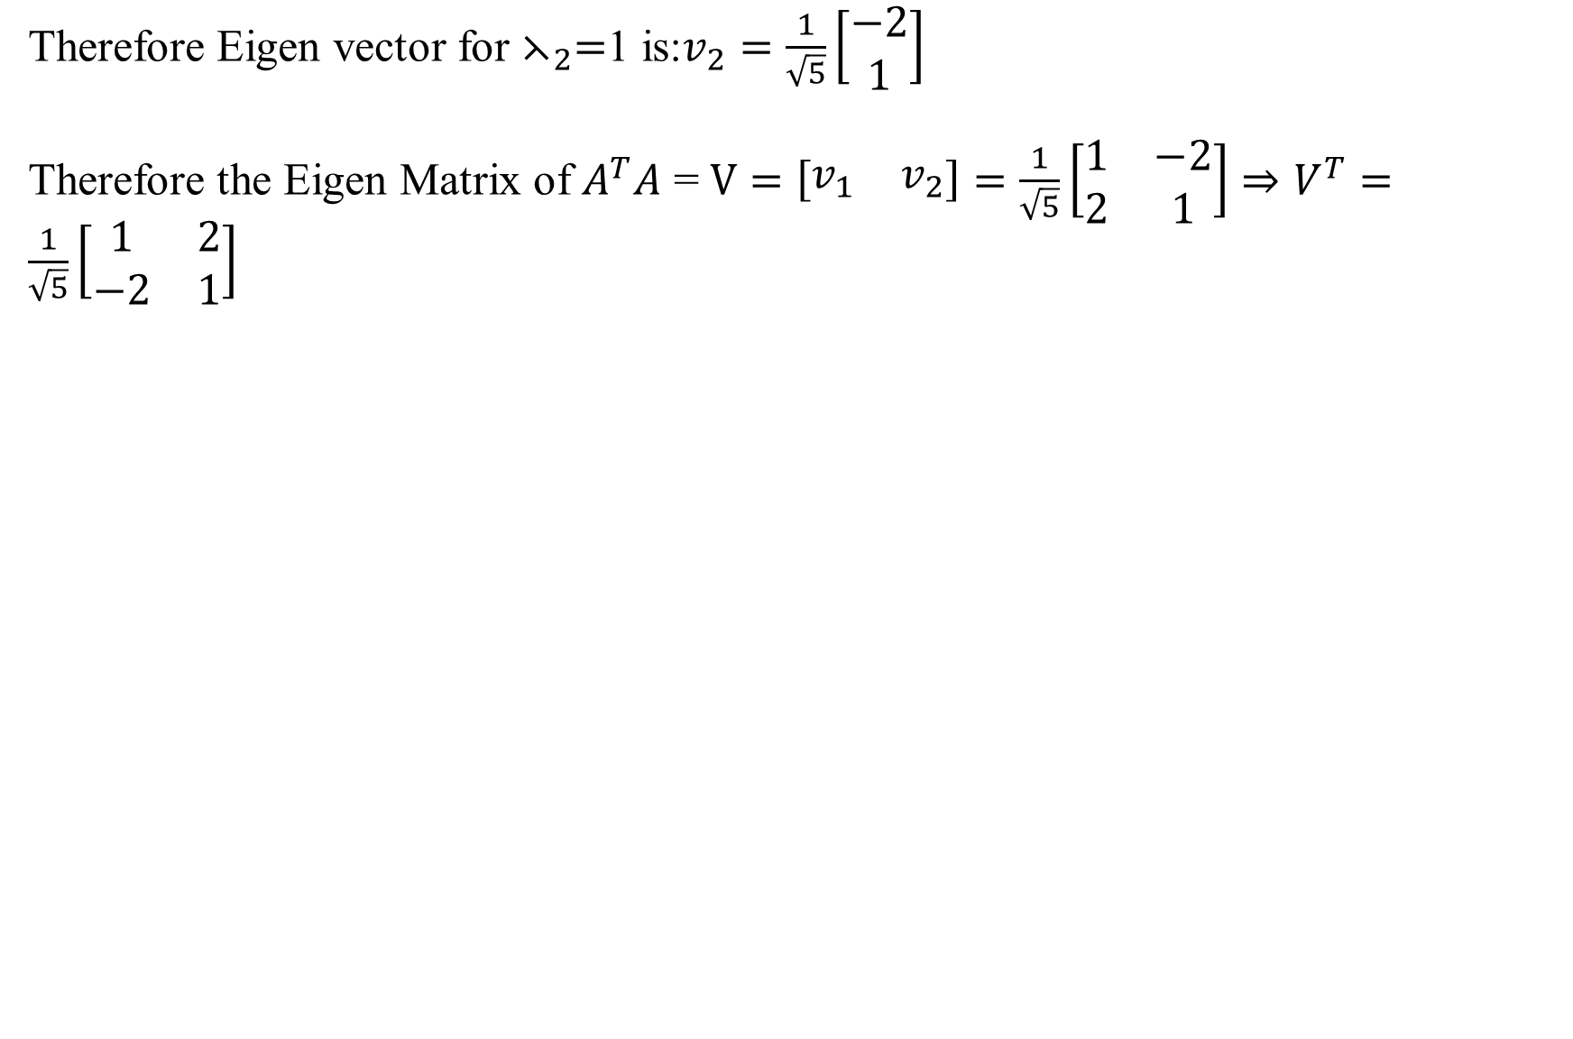
Singular Value Decomposition (SVD)
Sing Singular Value Decomposition (SVD)
Singular Value Decomposition (SVD) (Cont..II)
Therefore Eigen vector for $⋋_{2}=$1 is:$v_{2}=\frac{1}{\sqrt{5}}\left[\begin{matrix}−2 \\ 1\end{matrix}\right]$
Therefore the Eigen Matrix of $A^{T}A$ = $V=\left[\begin{matrix}v_{1} & v_{2}\end{matrix}\right]=\frac{1}{\sqrt{5}}\left[\begin{matrix}1 & −2 \\ 2 & 1\end{matrix}\right]⇒V^{T}=\frac{1}{\sqrt{5}}\left[\begin{matrix}1 & 2 \\ −2 & 1\end{matrix}\right]$
this with help of an

Slide 32
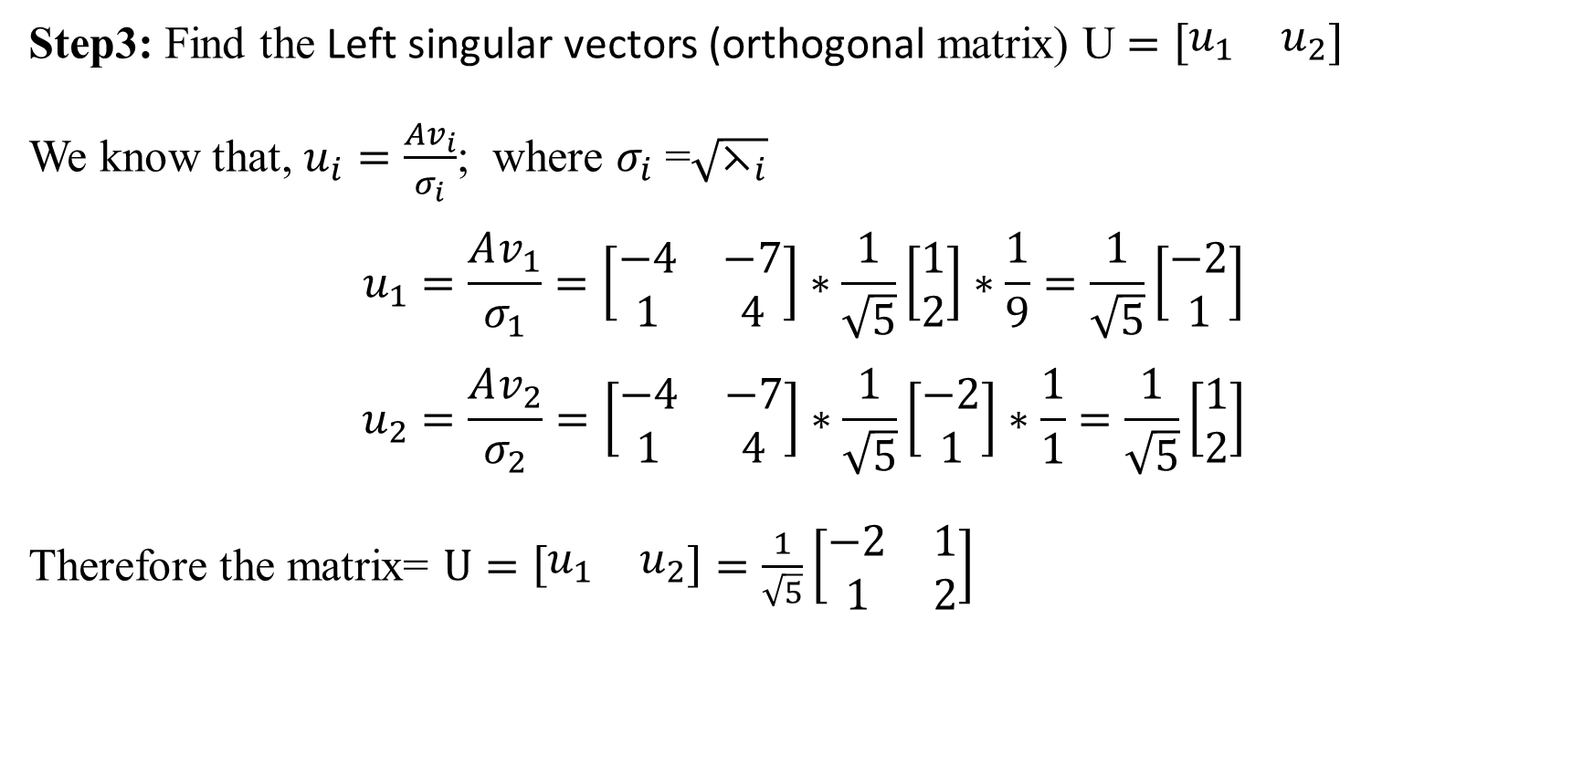
Singular Value Decomposition (SVD)
Sing Singular Value Decomposition (SVD)
Singular Value Decomposition (SVD) (Cont..III)
Step3: Find the Left singular vectors (orthogonal matrix) U $=\left[\begin{matrix}u_{1} & u_{2}\end{matrix}\right]$
We know that, $u_{i}=\frac{Av_{i}}{σ_{i}}$; where $σ_{i}$ =$\sqrt{⋋_{i}}$
$$u_{1}=\frac{Av_{1}}{σ_{1}}=\left[\begin{matrix}−4 & −7 \\ 1 & 4\end{matrix}\right]∗\frac{1}{\sqrt{5}}\left[\begin{matrix}1 \\ 2\end{matrix}\right]∗\frac{1}{9}=\frac{1}{\sqrt{5}}\left[\begin{matrix}−2 \\ 1\end{matrix}\right]$$
$$u_{2}=\frac{Av_{2}}{σ_{2}}=\left[\begin{matrix}−4 & −7 \\ 1 & 4\end{matrix}\right]∗\frac{1}{\sqrt{5}}\left[\begin{matrix}−2 \\ 1\end{matrix}\right]∗\frac{1}{1}=\frac{1}{\sqrt{5}}\left[\begin{matrix}1 \\ 2\end{matrix}\right]$$
Therefore the matrix= $U=\left[\begin{matrix}u_{1} & u_{2}\end{matrix}\right]=\frac{1}{\sqrt{5}}\left[\begin{matrix}−2 & 1 \\ 1 & 2\end{matrix}\right]$

Slide 33
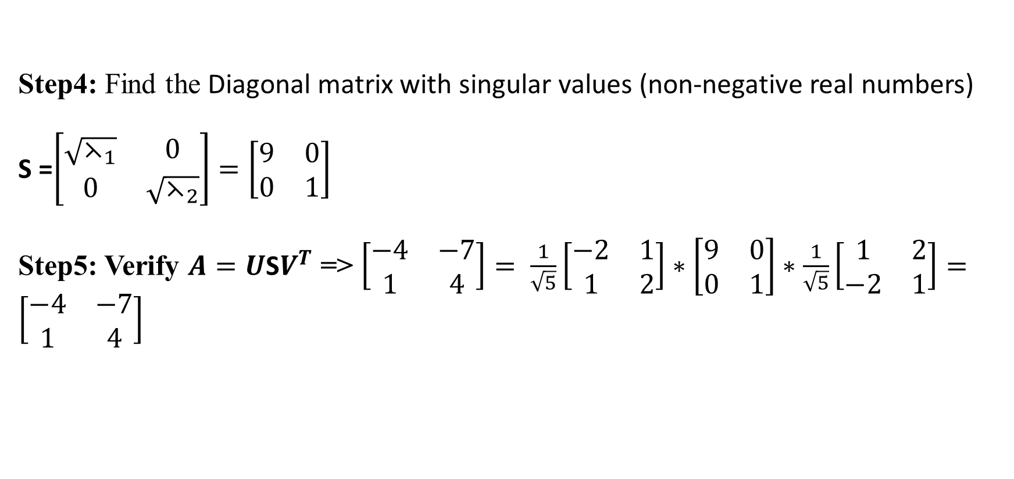
Singular Value Decomposition (SVD)
Sing Singular Value Decomposition (SVD)
Singular Value Decomposition (SVD) (Cont..III)
Step4: Find the Diagonal matrix with singular values (non-negative real numbers)
S =$\left[\begin{matrix}\sqrt{⋋_{1}} & 0 \\ 0 & \sqrt{⋋_{2}}\end{matrix}\right]=\left[\begin{matrix}9 & 0 \\ 0 & 1\end{matrix}\right]$
Step5: Verify $A=U\text{S}V^{T}$ => $\left[\begin{matrix}−4 & −7 \\ 1 & 4\end{matrix}\right]=$ $\frac{1}{\sqrt{5}}\left[\begin{matrix}−2 & 1 \\ 1 & 2\end{matrix}\right]∗\left[\begin{matrix}9 & 0 \\ 0 & 1\end{matrix}\right]∗\frac{1}{\sqrt{5}}\left[\begin{matrix}1 & 2 \\ −2 & 1\end{matrix}\right]=\left[\begin{matrix}−4 & −7 \\ 1 & 4\end{matrix}\right]$

Slide 34
Summary
We learned:
- Vectors & operations
- Matrices & properties
- Eigen decomposition
- SVD and applications
All with simple examples

Slide 35
Thank You

